Slide 1
Introduction to girls child education
Every day, girls pace barrier to education caused by poverty, cultural norms and practices among others.
Achieving gender equality is central to the world bank.

Slide 2
Aims and Objectives
Aims
Objectives
To access the performance between boys and girls.
To find out gender parity between boys and girls
To identify who has the highest performance between boys and girls

Slide 3
Methodology
Secondary data is used for this study, the data was collected from exam office from selected secondary school.
Excel was used for data analysis and visualisation.

Slide 4
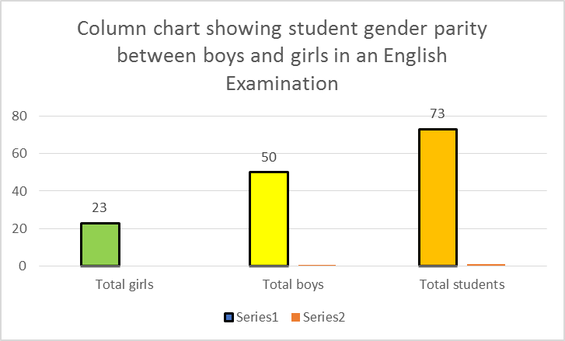
Result analysis
This is a class of 73 students who wrote English exam. 50 out of the 73 are boys while 23 out of the 73 are girls. This shows that there is un equality between boys and girls in the class. Even though the boys are more than the girls, there is fair representation of the girls. How ever there is need to mobilize for more enrolment of the girl so that we may have equal gender parity

Slide 5
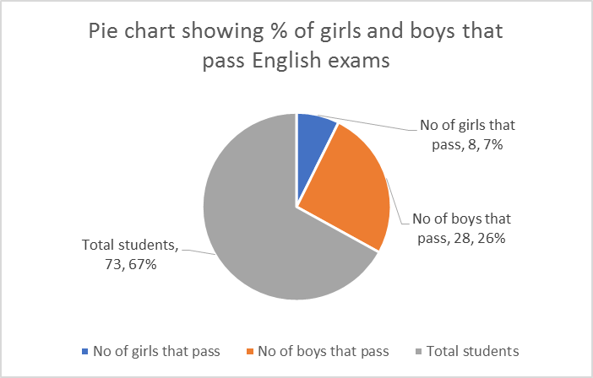
Result analysis
In a class of 73 student who wrote English exams
8.7% of girls pass English out of 23 girls while 28.26% boy passed English out of 50 boys

Slide 6
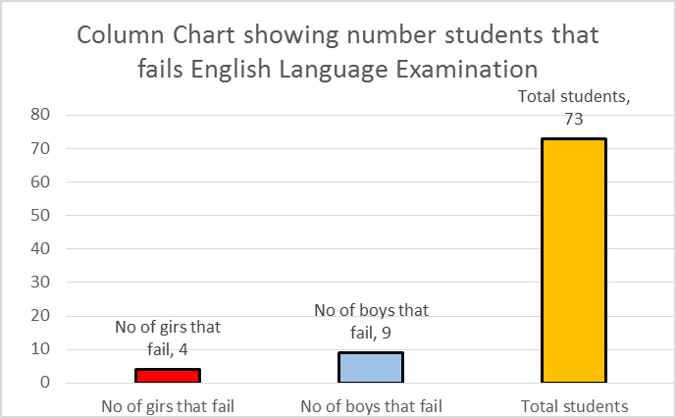
Result analysis
Only 4 of girls out 0f 23 fall English exams while 9 boys out of 50 fall English language .

Slide 7
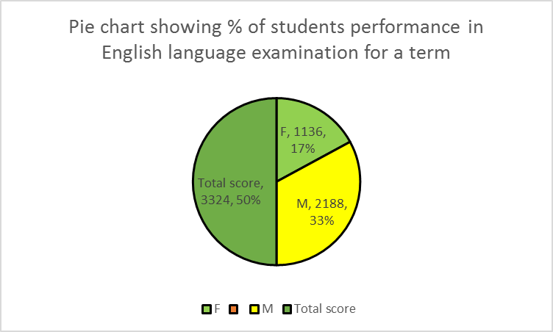
Result analysis
After the examination 17% of girls pass English while 35% of boys pass English
There fore boys has highest performance in English than girls

Slide 8
Summary and conclusion
Summary
Recommendation
There is a gender parity inequality between girls and boys as seen in class of 73 only 23 are girls
There is a task for world bank
to put more effort, innovations to to ensure the equality of girls participation in school

